Slide 1
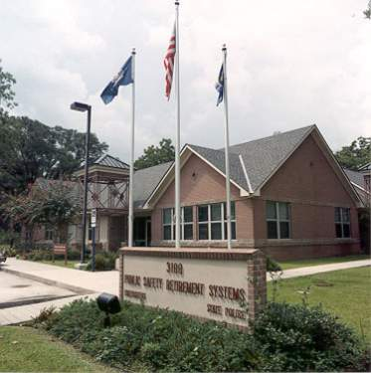
FIREFIGHTERS RETIREMENT SYSTEM
Phone- (225) 925-4060 Email- fireret@ffret.com URL- ffret.com

Slide 3
24.00
25.25
9.00

Slide 4
24.00
9.00

Slide 5
24.00

Slide 7
25.25

Slide 8
25.25

Slide 9
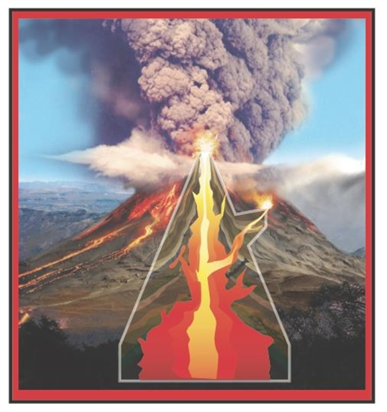
24.00
9.00

Slide 10
FRS Financially Impactive Events
In 1992, the legislature passed Act No. 1053 which granted military service credit in FRS at no cost to members who left the fire service to fight in the Persian Gulf conflict. In 1999, it passed Act No. 1370 which granted military service credit in FRS to any member who served in the military between 1960-1975 by paying only the employee contributions, without interest. In 2001 it passed Act No. 1176 repealing the foregoing costly laws. The impact was the granting of a millennium of service credit (973 years) which ordinarily would have cost multiples of 10s of millions of dollars, but instead, the system only received $1.5 million dollars in payment. Now a crest wave of members who received that credit are retiring and FRS is paying benefits without having collected sufficient dollars in advance.
In 2001, the legislature passed Act No. 1160 which had the effect of reducing the amount of funding that FRS was previously allocated from the Insurance Premium Tax Fund.

Slide 11
24.00
9.00

Slide 12
24.00
9.00

Slide 13
24.00
9.00

Slide 14
Actuarial Valuation Rate
AVR
7.00%
IPTF
1/4ths
AVR
7.50%
CSG
24.00

Slide 18
24.00
12.50
10.40
12.30
17.20
FRS Investment Returns (%) 2005-2009

Slide 19
NEPC
29.25

Slide 20
FRS Investment Returns (%) 2013-2017
10.50
11.40
-0.20
-2.30
13.60

Slide 21
25.25
FRS Investment Returns (%) 2017-2021
13.60
6.50
4.40
3.10
26.10

Slide 22
Actuarial Valuation Rate
AVR
7.00%
AVR
7.50%
Actuarial Valuation Rate
7.50%
7.50%
7.40%
7.30%
7.15%
2022
7.00%
AVR
2022
33.75%
Er Rate
24.00
2023
6.90%
AVR
2023
33.25%
Er Rate
Employer Contribution Rate
25.25%
26.50%
26.25%
27.75%
32.25%

Slide 31
$1.75 Million
0.07%
$645 Million
$447 Thousand
0.07%

Slide 32
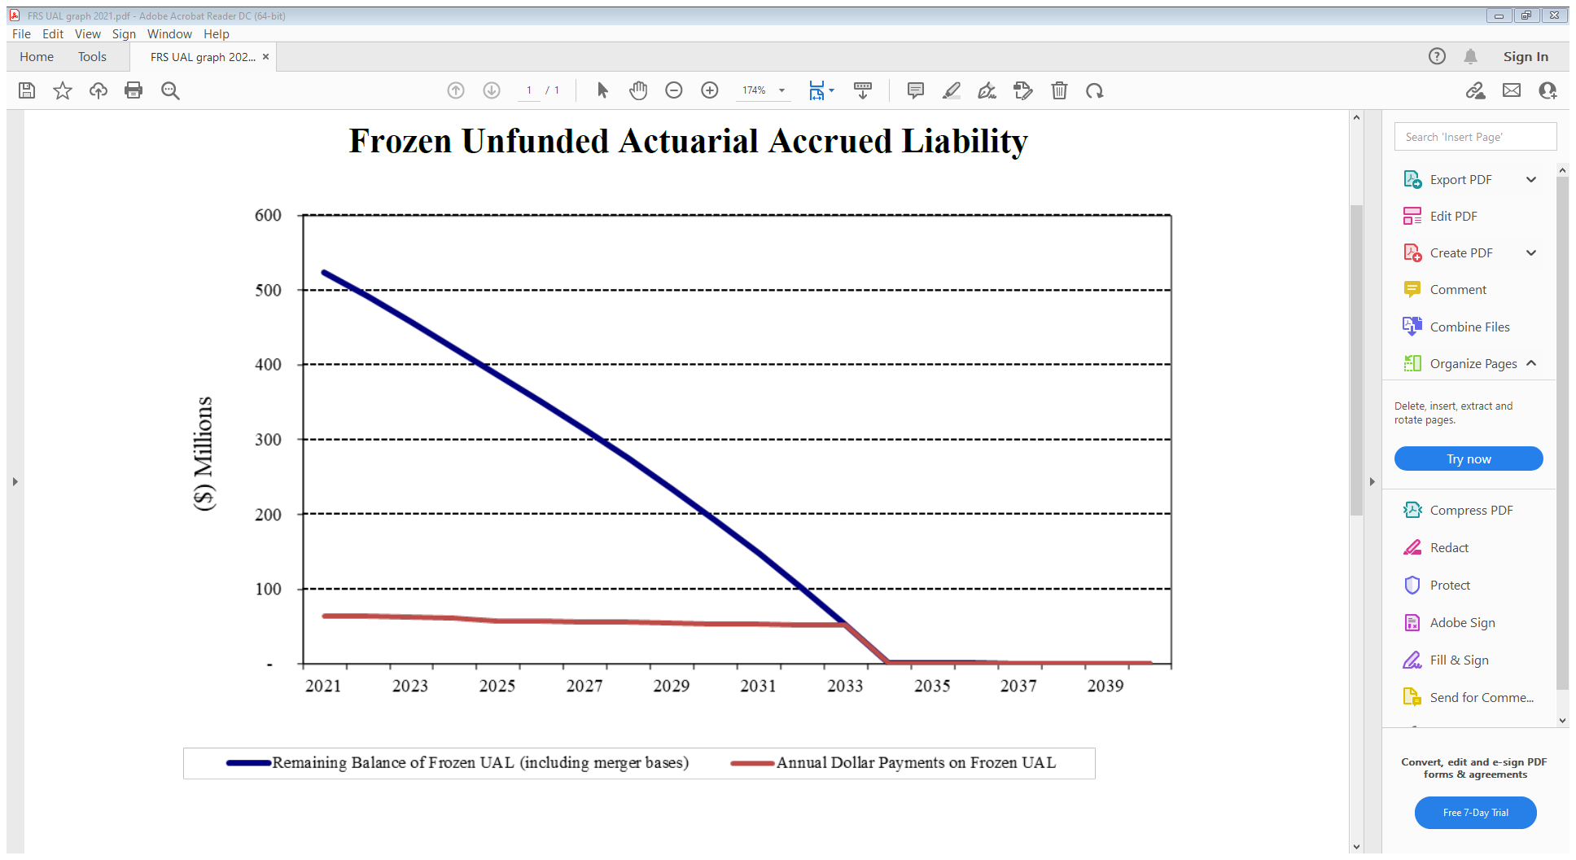

Slide 33
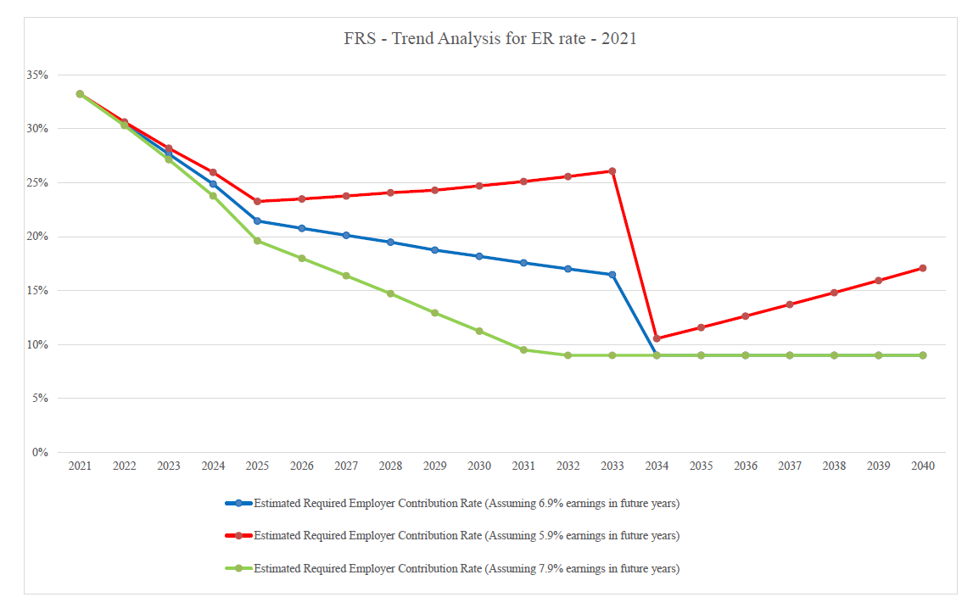

Slide 40
Investment Questions
I earned 31% on my investments last year, so why didn’t FRS earn more than me?
My investment guy says I should take my money out of DROP and let his company invest it for me. Why shouldn’t I just do that?
Exactly whose brother-in-law is investing our money? How are managers selected? Who is lining their pockets with fees? How are fees kept under control?
Actuarial Questions
We are told every year that our money is safe and the retirement system is sound. Is it?
Why does the employer contribution rate keep going up?
Will the employer contribution rate go down in future years? What about the employee rate?

Slide 41
FIREFIGHTERS RETIREMENT SYSTEM
Phone- (225) 925-4060 Email- fireret@ffret.com URL- ffret.com

